Slide 1
INSTRUCTION SET OF 8085

Slide 2
MVI-Move immediate 8-bit
Opcode Operand
MVI
Rd, Data M, Data
The 8-bit data is stored in the destination register or memory.
If the operand is a memory location, its location is specified by the contents of the H-L registers.
Example: MVI B, 60H or MVI M, 40H

Slide 3


BEFORE EXECUTION
AFTER EXECUTION
A F
B |  | C
D E
H L
A F
B | 60 | C
D E
H L
MVI B,60H
BEFORE EXECUTION
AFTER EXECUTION
204FH
204F
HL=2050
HL=2050
40
MVI M,40H
2051H
2051H

Slide 4
LDA-Load accumulator
Opcode
Operand
LDA
16-bit address
The contents of a memory location, specified by a 16- bit address in the operand, are copied to the accumulator.
The contents of the source are not altered.
Example: LDA 2000H

Slide 5
BEFORE EXECUTION
AFTER EXECUTION
A
A
30
LDA 2000H
3E
30
C 000H
2000H
DATA 1
C 001H

Slide 6
Write an assembly language program to add two 8 bit numbers
ADDRESS | OPCODE | MNEMONIC | OPERAND | COMMENTS
C000 | 3E , Data1 | MVI | A, Data1 | Get first byte in the accumulator
C002 | 06 , Data2 | MVI | B, Data2 | Get Second byte in register B
C004 | 88 | ADD | B | Addition of Data1 (A) + Data2 (B). Result is saved in accumulator A.
C005 | 76 | HLT (RST 1) |  | Halt/end the program

Slide 7
LDAX-Load accumulator indirect
Opcode Operand
LDAX
B/D Register Pair
The contents of the designated register pair point to a memory location.
This instruction copies the contents of that memory location into the accumulator.
The contents of either the register pair or the memory location are not altered.
Example: LDAX D

Slide 8
AFTER EXECUTION
BEFORE EXECUTION
A
F
A
80
F
B
C
80
B
C
80
2030H
2030H
LDAX D
D 20 E 30
D 20 E 30

Slide 9
LXI-Load register pair immediate
Opcode Operand
LXI
Reg. pair, 16-bit data
This instruction loads 16-bit data in the register pair.
Example: LXI H, 2030 H

Slide 10
BEFORE EXECUTION
AFTER EXECUTION
A
F
A |  | F
B |  | C
H | 30 | L | 20
B
C
90
50
90
2030H
2030H
H L
1F
2031H
LXI H, 2030
M=50

Slide 11
LHLD-Load H and L registers direct
Opcode Operand
LHLD
16-bit address
This instruction copies the contents of memory location pointed out by 16-bit address into register L.
It copies the contents of next memory location into register H.
Example: LHLD 2030 H

Slide 12
BEFORE EXECUTION
AFTER EXECUTION
A
F
A | 80 | F
B |  | C
H | 85 | L | 00
B
C
00
60
2030H
8500H
LHLD 2030
H L
85
M=60

Slide 13
Opcode Operand
STA-Store accumulator direct
STA
16-bit address
The contents of accumulator are copied into the memory location specified by the operand.
Example: STA 2000H

Slide 14
BEFORE EXECUTION
AFTER EXECUTION
A
50
A
50
STA 2000H
50
2000H
2000H

Slide 15
STAX-Store accumulator indirect
Opcode Operand
STAX
Reg. pair
The contents of accumulator are copied into the memory location specified by the contents of the register pair.
Example: STAX B
collected by C.Gokul AP/EEE , Velalar college of Engineering and Technology, Erode

Slide 16
BEFORE EXECUTION
B 85 C 00
AFTER EXECUTION
8500H
1A
A=1AH
STAX B

Slide 17
SHLD-Store H and L registers direct
Opcode Operand SHLD 16-bit address
The contents of register L are stored into memory location specified by the 16-bit address.
The contents of register H are stored into the next memory location.
Example: SHLD 8550H

Slide 18
BEFORE EXECUTION
AFTER EXECUTION
D E
H | 70 | L | 80
8500H
80
70
SHLD 8500
8501H

Slide 19
XCHG-Exchange H and L with D and E
Opcode Operand
XCHG None
The contents of register H are exchanged with the contents of register D.
The contents of register L are exchanged with the contents of register E.
Example: XCHG

Slide 20

BEFORE EXECUTION
AFTER EXECUTION
D | 20 E | 40
H | 70 L | 80
D | 70 | E | 80
H | 20 | L | 40
XCHG

Slide 21
SPHL-Copy H and L registers to the stack pointer
Opcode Operand
SPHL
None
This instruction loads the contents of H-L pair into SP.
Example: SPHL

Slide 22
BEFORE EXECUTION
SP
H | 25 | L | 00
SPHL
AFTER EXECUTION
SP H
2500
25 L
00

Slide 23
XTHL-Exchange H and L with top of stack
Opcode Operand
XTHL None
The contents of L register are exchanged with the location pointed out by the contents of the SP.
The contents of H register are exchanged with the next location (SP + 1).
Example: XTHL

Slide 24
L=SP H=(SP+1)
BEFORE EXECUTION
AFTER EXECUTION
SP
2700
50
SP |  | 2700
H | 60 | L | 50
40
2700H
2700H
H
30
L 40
60
30
2701H
2701H
XTHL
2702H
2702H

Slide 25
Opcode | Operand | Description
PCHL | None | Load program counter with H- L contents
The contents of registers H and L are copied into the program counter (PC).
The contents of H are placed as the high-order byte and the contents of L as the low-order byte.
Example: PCHL

Slide 26
PUSH-Push register pair onto stack
Opcode Operand
PUSH Reg. pair
The contents of register pair are copied onto stack.
SP is decremented and the contents of high-order registers (B, D, H, A) are copied into stack.
SP is again decremented and the contents of low-order registers (C, E, L, Flags) are copied into stack.
Example: PUSH B

Slide 27
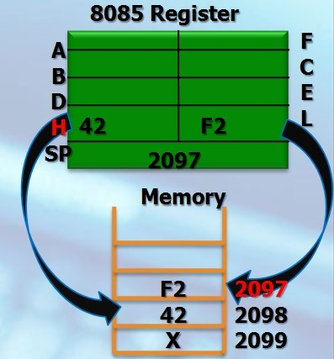
PUSH H

Slide 28
POP- Pop stack to register pair
Opcode Operand
POP Reg. pair
The contents of top of stack are copied into register pair.
The contents of location pointed out by SP are copied to the low-order register (C, E, L, Flags).
SP is incremented and the contents of location are copied to the high-order register (B, D, H, A).
Example: POP H

Slide 29
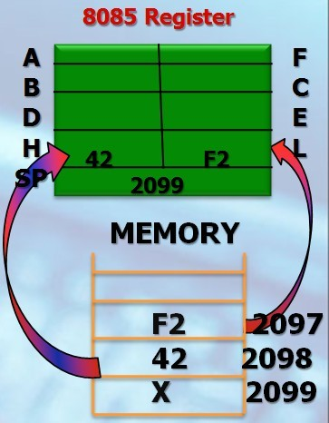
POP H

Slide 30
IN- Copy data to accumulator from a port with 8-bit address
Opcode Operand
IN
8-bit port address
The contents of I/O port are copied into accumulator.
Example: IN 8C H

Slide 31
A
BEFORE EXECUTION
PORT 80H
10
IN 80H
AFTER EXECUTION
PORT 80H
10
A
10

Slide 32
OUT- Copy data from accumulator to a port with 8-bit address
Opcode Operand
OUT
8-bit port address
The contents of accumulator are copied into the I/O port.
Example: OUT 78H

Slide 33
10
BEFORE EXECUTION
PORT 50H
A
40
OUT 50H
AFTER EXECUTION
PORT 50H
40
A 40

Slide 34
2.Arithmetic Instructions
These instructions perform the operations like:
Addition
Subtract
Increment
Decrement

Slide 35
Addition
Any 8-bit number, or the contents of register, or the contents of memory location can be added to the contents of accumulator.
The result (sum) is stored in the accumulator.
No two other 8-bit registers can be added directly.
Example: The contents of register B cannot be added directly to the contents of register C.

Slide 36
ADD
Opcode | Operand | Description
ADD | R M | Add register or memory to accumulator
The contents of register or memory are added to the contents of accumulator.
The result is stored in accumulator.
If the operand is memory location, its address is specified by H-L pair.
Example: ADD B or ADD M

Slide 37
BEFORE EXECUTION
AFTER EXECUTION
09
C
D E
H L
A | 04
B | C |  | 05
D | E
H | L
ADD C A=A+C
05
04+05=09
BEFORE EXECUTION
AFTER EXECUTION
04
A
B
A
ADD M A=A+M
14
B
C
C
D
E
E
H 20 L
04+10=14
D
H 20 L
50
10
50
10
2050
2050

Slide 38
ADC
Opcode | Operand | Description
ADC | R M | Add register or memory to accumulator with carry
The contents of register or memory and Carry Flag (CY) are added to the contents of accumulator.
The result is stored in accumulator.
If the operand is memory location, its address is specified by H-L pair.
All flags are modified to reflect the result of the addition.
Example: ADC B or ADC M

Slide 39
BEFORE EXECUTION
AFTER EXECUTION
CY
01
A 56
A
50
B
C
05
B
C
20
ADC C A=A+C+CY
D
E
D
E
H
L
H
L
50+05+01=56
BEFORE EXECUTION
AFTER EXECUTION
CY
1
2050H
30
ADC M A=A+M+CY
2050H
30
A
06
A
37
H
20
L
50
H 20 L
06+1+30=37
50

Slide 40
ADI
Opcode | Operand | Description
ADI | 8-bit data | Add immediate to accumulator
The 8-bit data is added to the contents of accumulator.
The result is stored in accumulator.
All flags are modified to reflect the result of the addition.
Example: ADI 45 H

Slide 41
BEFORE EXECUTION
AFTER EXECUTION
A
03
A
08
ADI 05H A=A+DATA(8)
03+05=08
collected by C.Gokul AP/EEE , Velalar college of Engineering and Technology, Erode

Slide 42
ACI
Opcode | Operand | Description
ACI | 8-bit data | Add immediate to accumulator with carry
The 8-bit data and the Carry Flag (CY) are added to the contents of accumulator.
The result is stored in accumulator.
All flags are modified to reflect the result of the addition.
Example: ACI 45 H

Slide 43
BEFORE EXECUTION
AFTER EXECUTION
CY | 1
A | 05
ACI 20H A=A+DATA (8)+CY
A
26
05+20+1=26

Slide 44
DAD
Opcode | Operand | Description
DAD | Reg. pair | Add register pair to H-L pair
The 16-bit contents of the register pair are added to the contents of H-L pair.
The result is stored in H-L pair.
If the result is larger than 16 bits, then CY is set.
No other flags are changed.
Example: DAD B or DAD D

Slide 45
BEFORE EXECUTION
AFTER EXECUTION
D | 12 | E | 34
H | 23 | L | 45
D | 12 | E | 34
H | 35 | L | 79
DAD D
1234
2345 +
------- 3579
DAD D DAD B
HL=HL+DE HL=HL+BC

Slide 46
Subtraction
Any 8-bit number, or the contents of register, or the contents of memory location can be subtracted from the contents of accumulator.
The result is stored in the accumulator.
Subtraction is performed in 2’s complement form.
If the result is negative, it is stored in 2’s complement form.
No two other 8-bit registers can be subtracted directly.
collected by C.Gokul AP/EEE,VCET

Slide 47
SUB
Opcode | Operand | Description
SUB | R M | Subtract register or memory from accumulator
The contents of the register or memory location are subtracted from the contents of the accumulator.
The result is stored in accumulator.
If the operand is memory location, its address is specified by H-L pair.
All flags are modified to reflect the result of subtraction.
Example: SUB B or SUB M

Slide 48
BEFORE EXECUTION
AFTER EXECUTION
05
C
D E
H L
A | 09
B | C |  | 04
D | E
H | L
SUB C A=A-C
04
09-04=05
BEFORE EXECUTION
AFTER EXECUTION
14
A
B
A
SUB M A=A-M
04
B
C
C
D
E
D
H 20 L
14-10=04
E
H 20 L
50
10
50
10
2050
2050

Slide 49
SBB
Opcode | Operand | Description
SBB | R M | Subtract register or memory from accumulator with borrow
The contents of the register or memory location and Borrow Flag (i.e. CY) are subtracted from the contents of the accumulator.
The result is stored in accumulator.
If the operand is memory location, its address is specified by H-L pair.
All flags are modified to reflect the result of subtraction.
Example: SBB B or SBB M

Slide 50
BEFORE EXECUTION
AFTER EXECUTION
CY
01
A 02
A
08
B
C
05
B
C
05
SBB C A=A-C-CY
D
E
D
E
H L
08-05-01=02
H
L
BEFORE EXECUTION
AFTER EXECUTION
 | CY | 1
 | A | 06
H | 20 | L | 50
2050H
02
SBB M
2050H
02
A
03
A=A-M-CY
H
20 L
06-02-1=03
50

Slide 51
SUI
Opcode | Operand | Description
SUI | 8-bit data | Subtract immediate from accumulator
The 8-bit data is subtracted from the contents of the accumulator.
The result is stored in accumulator.
All flags are modified to reflect the result of subtraction.
Example: SUI 05H

Slide 52
BEFORE EXECUTION
AFTER EXECUTION
A
08
A
03
SUI 05H
A=A-DATA(8)
08-05=03

Slide 53
SBI
Opcode
Operand
Description
SBI
8-bit data
Subtract immediate from accumulator with borrow
The 8-bit data and the Borrow Flag (i.e. CY) is subtracted from the contents of the accumulator.
The result is stored in accumulator.
All flags are modified to reflect the result of subtraction.
Example: SBI 45 H
collected by C.Gokul AP/EEE,VCET

Slide 54
BEFORE EXECUTION
AFTER EXECUTION
CY | 1
A | 25
S B I 20H A=A-DATA (8)-CY
A
04
25-20-01=04

Slide 55
Increment / Decrement
The 8-bit contents of a register or a memory location can be incremented or decremented by 1.
The 16-bit contents of a register pair can be incremented or decremented by 1.
Increment or decrement can be performed on any register or a memory location.

Slide 56
INR
Opcode | Operand | Description
INR | R M | Increment register or memory by 1
The contents of register or memory location are incremented by 1.
The result is stored in the same place.
If the operand is a memory location, its address is specified by the contents of H-L pair.
Example: INR B or INR M

Slide 57
BEFORE EXECUTION
AFTER EXECUTION
A
B | 10 | C
D E
H L
A
A
INR B R=R+1
B
10
C
B | 11 | C
D E
H L
D
E
H
L
10+1=11
BEFORE EXECUTION
AFTER EXECUTION
H
L
10
H
L
11
2050H
INR M
2050H
20
50
20
50
M=M+1
10+1=11

Slide 58
INX
Opcode | Operand | Description
INX | R | Increment register pair by 1
The contents of register pair are incremented by 1.
The result is stored in the same place.
Example: INX H or INX B or INX D
HL=2050 BC 9090
2051

Slide 59
BEFORE EXECUTION
AFTER EXECUTION
SP
SP
B |  | C
D |  | E
H | 10 | L | 21
B
C
INX H RP=RP+1
D
E
H 10 L 20
1020+1=1021

Slide 60
DCR
Opcode | Operand | Description
DCR | R M | Decrement register or memory by 1
The contents of register or memory location are decremented by 1.
The result is stored in the same place.
If the operand is a memory location, its address is specified by the contents of H-L pair.
Example: DCR B or DCR M

Slide 61
BEFORE EXECUTION
AFTER EXECUTION
A
B | C
D | E | 20
H | L
A
DCR E R=R-1
B
C
D
E
19
H L
20-1=19
AFTER EXECUTION
BEFORE EXECUTION
H
L
20
H
L
2050H
21
20
50
DCR M M=M-1
2050H
20
50
21-1=20

Slide 62
DCX
Opcode | Operand | Description
DCX | R | Decrement register pair by 1
The contents of register pair are decremented by 1.
The result is stored in the same place.
Example: DCX H or DCX B or DCX D
2088

Slide 63
BEFORE EXECUTION
AFTER EXECUTION
SP
SP
B |  | C
D |  | E
H | 10 | L | 20
B
C
DCX H RP=RP-1
D
E
H 10 L 21

Slide 64
3.Logical Instructions
These instructions perform logical operations on data stored in registers, memory and status flags.
The logical operations are:
AND
OR
XOR
Rotate
Compare
Complement

Slide 65
AND, OR, XOR
Any 8-bit data, or the contents of register, or memory location can logically have
AND operation
OR operation
XOR operation
with the contents of accumulator.
The result is stored in accumulator.

Slide 66
Opcode | Operand | Description
ANA | R M | Logical AND register or memory with accumulator
The contents of the accumulator are logically ANDed with the contents of register or memory.
The result is placed in the accumulator.
If the operand is a memory location, its address is specified by the contents of H-L pair.
S, Z, P are modified to reflect the result of the operation.
CY is reset and AC is set.
Example: ANA B or ANA M.
collected by C.Gokul AP/EEE,VCET

Slide 67

BEFORE EXECUTION
1010 1010=AAH
0000 1111=0FH
AFTER EXECUTION
CY 0 AC 1
CY AC
0000 1010=0AH
A | AA
B | 0F | C
D E
H L
A
0A
A
B
10
C
ANA B
A=A and R
B | 0F | C
D |  | E
H |  | L
D
E
H
L
BEFORE EXECUTION
AFTER EXECUTION
0101 0101=55H
1011 0011=B3H
CY
AC
CY 0 AC 1
B3
0001 0001=11H
B3
A
55
2050H
A
11
2050H
H 20 L
50
ANA M
A=A and M
H 20 L 50

Slide 68
Opcode | Operand | Description
ANI | 8-bit data | Logical AND immediate with accumulator
The contents of the accumulator are logically ANDed with the 8-bit data.
The result is placed in the accumulator.
S, Z, P are modified to reflect the result.
CY is reset, AC is set.
Example: ANI 86H.

Slide 69

BEFORE EXECUTION
AFTER EXECUTION
1011 0011=B3H
0011 1111=3FH
0011 0011=33H
CY
AC
1
CY
AC
ANI 3FH
A=A and DATA(8) A
0
A
B3
33

Slide 70
Opcode | Operand | Description
ORA | R M | Logical OR register or memory with accumulator
The contents of the accumulator are logically ORed with the contents of the register or memory.
The result is placed in the accumulator.
If the operand is a memory location, its address is specified by the contents of H-L pair.
S, Z, P are modified to reflect the result.
CY and AC are reset.
Example: ORA B or ORA M.

Slide 71
1010 1010=AAH
0001 0010=12H
BEFORE EXECUTION
AFTER EXECUTION
1011 1010=BAH
CY AC
CY 0 AC 0
ORA B
A=A or R
A
AA
A
BA
B
12 C
B
12 C
D
E
D
E
H
L
H
L

Slide 72
0101 0101=55H
1011 0011=B3H
BEFORE EXECUTION
AFTER EXECUTION
1111 0111=F7H
CY AC
CY
AC 0
0
ORA M
A=A or M
2050H
B3
2050H
B3
A
55
A
F7
H 20 L
50
H 20 L
50

Slide 73
Opcode | Operand | Description
ORI | 8-bit data | Logical OR immediate with accumulator
The contents of the accumulator are logically ORed with the 8-bit data.
The result is placed in the accumulator.
S, Z, P are modified to reflect the result.
CY and AC are reset.
Example: ORI 86H.

Slide 74
1011 0011=B3H
0000 1000=08H
BEFORE EXECUTION
1011 1011=BBH
AFTER EXECUTION
CY
AC
ORI 08H
A=A or DATA(8)
CY | 0 | AC 0
A | BB
A
B3

Slide 75
Opcode | Operand | Description
XRA | R M | Logical XOR register or memory with accumulator
The contents of the accumulator are XORed with the contents of the register or memory.
The result is placed in the accumulator.
If the operand is a memory location, its address is specified by the contents of H-L pair.
S, Z, P are modified to reflect the result of the operation.
CY and AC are reset.
Example: XRA B or XRA M.

Slide 76
BEFORE EXECUTION
1010 1010=AAH
0010 1101=2DH
AFTER EXECUTION
1000 0111=87H
CY
AC
CY 0 AC 0
A
AA
A
87
A
B
C
2D
XRA C
A=A xor R
B
C
2D
B
10
C
D
E
D
E
D
E
H
L
H
L
H
L

Slide 77
BEFORE EXECUTION
0101 0101=55H
1011 0011=B3H
AFTER EXECUTION
1110 0110=E6H
CY
AC
CY 0 AC 0
XRA M
A=A xor M
2050H
B3
2050H
B3
A
55
A
E6
H 20 L
50
H 20 L
50

Slide 78
Opcode | Operand | Description
XRI | 8-bit data | XOR immediate with accumulator
The contents of the accumulator are XORed with the 8-bit data.
The result is placed in the accumulator.
S, Z, P are modified to reflect the result.
CY and AC are reset.
Example: XRI 86H.

Slide 79
1011 0011=B3H
0011 1001=39H
BEFORE EXECUTION
1000 1010=8AH
AFTER EXECUTION
CY
AC
XRI 39H
A=A xor DATA(8)
CY | 0 | AC 0
A | 8A
A
B3

Slide 80
Compare
Any 8-bit data, or the contents of register, or memory location can be compares for:
Equality
Greater Than
Less Than
with the contents of accumulator.
The result is reflected in status flags.

Slide 81
Opcode | Operand | Description
CMP | R M | Compare register or memory with accumulator
The contents of the operand (register or memory) are compared with the contents of the accumulator.
Both contents are preserved .

Slide 82
BEFORE EXECUTION
A>R: CY=0 A=R: ZF=1 A<R: CY=1
AFTER EXECUTION
CY Z
CY | 01 | Z | 0
A | 10
B |  | C
D | 20 | E
H |  | L
A | 10
B C
D | 20 | E
H L
A
B
10
C
CMP D A-R
D
E
H
L
10<20:CY=01
BEFORE EXECUTION
A>M: CY=0 A=M: ZF=1 A<M: CY=1
AFTER EXECUTION
CY
Z
CY 0
ZF
1
B8
B8
A
B8
2050H
CMP M A-M
A B8 2050H
H 20 L
50
H 20 L 50
B8=B8 :ZF=01

Slide 83
Opcode | Operand | Description
CPI | 8-bit data | Compare immediate with accumulator
The 8-bit data is compared with the contents of accumulator.
The values being compared remain unchanged.

Slide 84
BEFORE EXECUTION
AFTER EXECUTION
A>DATA: CY=0 A=DATA: ZF=1 A<DATA: CY=1
CY
Z
CPI 30H A-DATA
CY | 0 | AC 0
A | BA
A
BA
BA>30 :
CY=00

Slide 85

Rotate
Each bit in the accumulator can be shifted either left or right to the next position.

Slide 86
Opcode | Operand | Description
RLC | None | Rotate accumulator left
Each binary bit of the accumulator is rotated left by one position.
Bit D7 is placed in the position of D0 as well as in the Carry flag.
CY is modified according to bit D7.
S, Z, P, AC are not affected.
Example: RLC.

Slide 87




BEFORE EXECUTION
CY
B7 B6 B5 B4 B3 B2 B1 B0
AFTER EXECUTION
B7
B6 B5 B4 B3 B2 B1 B0 B7

Slide 88
Opcode | Operand | Description
RRC | None | Rotate accumulator right
Each binary bit of the accumulator is rotated right by one position.
Bit D0 is placed in the position of D7 as well as in the Carry flag.
CY is modified according to bit D0.
S, Z, P, AC are not affected.
Example: RRC.

Slide 89




BEFORE EXECUTION
B7
B6
B5
B4
B3
B2
B1
B0
CY
AFTER EXECUTION
B0 B7 B6 B5 B4 B3 B2 B1
B0
collected by C.Gokul AP/EEE , Velalar college of Engineering and Technology, Erode

Slide 90
Opcode | Operand | Description
RAL | None | Rotate accumulator left through carry
Each binary bit of the accumulator is rotated left by one position through the Carry flag.
Bit D7 is placed in the Carry flag, and the Carry flag is placed in the least significant position D0.
CY is modified according to bit D7.
S, Z, P, AC are not affected.
Example: RAL.

Slide 91


BEFORE EXECUTION
CY
B7 B6 B5 B4 B3 B2 B1 B0
AFTER EXECUTION
B7
B6 B5 B4 B3 B2 B1 B0 CY

Slide 92
Opcode | Operand | Description
RAR | None | Rotate accumulator right through carry
Each binary bit of the accumulator is rotated right by one position through the Carry flag.
Bit D0 is placed in the Carry flag, and the Carry flag is placed in the most significant position D7.
CY is modified according to bit D0.
S, Z, P, AC are not affected.
Example: RAR.

Slide 93


BEFORE EXECUTION
B7 B6 B5 B4 B3 B2 B1 B0
CY
AFTER EXECUTION
CY B7 B6 B5 B4 B3 B2 B1
B0

Slide 94
Complement
The contents of accumulator can be complemented.
Each 0 is replaced by 1 and each 1 is replaced by 0.

Slide 95
Opcode | Operand | Description
CMA | None | Complement accumulator
The contents of the accumulator are complemented.
No flags are affected.
Example: CMA. A=A’
BEFORE EXECUTION
AFTER EXECUTION
A
FF
A
00

Slide 96
Opcode | Operand | Description
CMC | None | Complement carry
The Carry flag is complemented.
No other flags are affected.
Example: CMC => c=c’
BEFORE EXECUTION
AFTER EXECUTION
C
0
C
1

Slide 97
Opcode | Operand |  | Description
STC | None | Set carry flag
The Carry flag is set to 1.
No other flags are affected.
Example: STC CF=1
S-set (1)
C-clear (0)

Slide 98

The branch group instructions allows the microprocessor to change the sequence of program either conditionally or under certain test conditions. The group includes,
(1) Jump instructions,
(2) Call and Return instructions,
(3) Restart instructions,

Slide 99
Opcode | Operand | Description
JMP | 16-bit address | Jump unconditionally
The program sequence is transferred to the memory location specified by the 16-bit address given in the operand.
Example: JMP 2034 H.

Slide 100
Opcode | Operand | Description
Jx | 16-bit address | Jump conditionally
The program sequence is transferred to the memory location specified by the 16-bit address given in the operand based on the specified flag of the PSW.
Example: JZ 2034 H.

Slide 101
C000 MVI A,20
;
;
C003 xx JMP C008 / NEXT/LABEL 1/
C004 08
Coo5 c0
C006 MVI B,34
COO8 NEXT ADDB
C009 HLT

Slide 102
Jump Conditionally
Opcode | Description | Status Flags
JC | Jump if Carry | CY = 1
JNC | Jump if No Carry | CY = 0
JZ | Jump if Zero | Z = 1
JNZ | Jump if No Zero | Z = 0
JPE | Jump if Parity Even | P = 1
JPO | Jump if Parity Odd | P = 0
A-Above , B-Below , C-Carry , Z-Zero , P-Parity

Slide 103
Opcode | Operand | Description
CALL | 16-bit address | Call unconditionally
The program sequence is transferred to the memory location specified by the 16-bit address given in the operand.
Before the transfer, the address of the next instruction after CALL (the contents of the program counter) is pushed onto the stack.
Example: CALL 2034 H.

Slide 104
Call Conditionally
Opcode | Description | Status Flags
CC | Call if Carry | CY = 1
CNC | Call if No Carry | CY = 0
CP | Call if Positive | S = 0
CM | Call if Minus | S = 1
CZ | Call if Zero | Z = 1
CNZ | Call if No Zero | Z = 0
CPE | Call if Parity Even | P = 1
CPO | Call if Parity Odd | P = 0

Slide 105
Opcode | Operand | Description
RET | None | Return unconditionally
The program sequence is transferred from the subroutine to the calling program.
The two bytes from the top of the stack are copied into the program counter, and program execution begins at the new address.
Example: RET.

Slide 106
Return Conditionally
Opcode | Description | Status Flags
RC | Return if Carry | CY = 1
RNC | Return if No Carry | CY = 0
RP | Return if Positive | S = 0
RM | Return if Minus | S = 1
RZ | Return if Zero | Z = 1
RNZ | Return if No Zero | Z = 0
RPE | Return if Parity Even | P = 1
RPO | Return if Parity Odd | P = 0

Slide 107
Opcode | Operand | Description
RST | 0 – 7 | Restart (Software Interrupts)
The RST instruction jumps the control to one of eight memory locations depending upon the number.
These are used as software instructions in a program to transfer program execution to one of the eight locations.
Example: RST 1 or RST 2 ….

Slide 108
Instruction Code | Vector Address
RST 0 | 0*8=0000H
RST 1 | 1*8=0008H
RST 2 | 2*8=0010H
RST 3 | 3*8=0018H
RST 4 | 4*8=0020H
RST 5 | 5*8=0028H
RST 6 | 6*8=0030H
RST 7 | 7*8=0038H

Slide 109
5. Control Instructions
The control instructions control the operation of microprocessor.
collected by C.Gokul AP/EEE , Velalar college of Engineering and Technology, Erode

Slide 110
Opcode | Operand | Description
NOP | None | No operation
No operation is performed.
The instruction is fetched and decoded but no operation is executed.
Example: NOP

Slide 111
Opcode | Operand |  | Description
HLT | None | Halt
The CPU finishes executing the current instruction and halts any further execution.
An interrupt or reset is necessary to exit from the halt state.
Example: HLT

Slide 112
Opcode | Operand | Description
DI | None | Disable interrupt
The interrupt enable flip-flop is reset and all the interrupts except the TRAP are disabled.
No flags are affected.
Example: DI

Slide 113
Opcode | Operand | Description
EI | None | Enable interrupt
The interrupt enable flip-flop is set and all interrupts are enabled.
No flags are affected.
This instruction is necessary to re-enable the interrupts (except TRAP).
Example: EI

Slide 114
Opcode | Operand | Description
RIM | None | Read Interrupt Mask
This is a multipurpose instruction used to read the status of interrupts 7.5, 6.5, 5.5 and read serial data input bit.
The instruction loads eight bits in the accumulator with the following interpretations.
Example: RIM

Slide 115

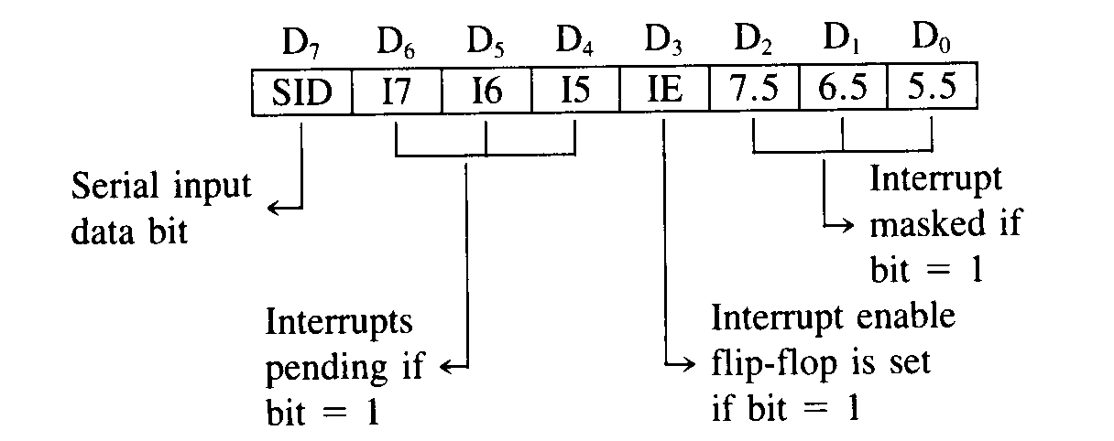
RIM Instruction

Slide 116
Opcode | Operand | Description
SIM | None | Set Interrupt Mask
This is a multipurpose instruction and used to implement the 8085 interrupts 7.5, 6.5, 5.5, and serial data output.
The instruction interprets the accumulator contents as follows.
Example: SIM

Slide 117
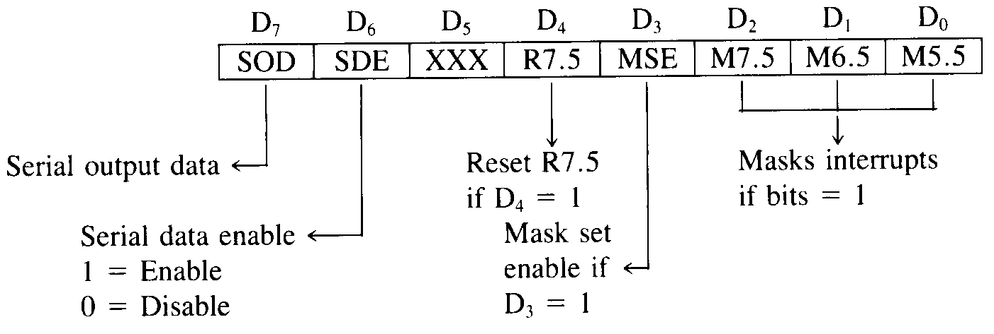
SIM Instruction

Slide 118
References
www.slideshare.net
www.docstoc.com
www.slideworld.com
www.nptel.ac.in
www.scribd.com
http://opencourses.emu.edu.tr/
http://engineeringppt.blogspot.in/
http://www.pptsearchengine.net/
www.4shared.com
www.eazynotes.com
http://8085projects.info/ Books:
Microprocessors and microcontrollers by krishnakanth Microprocessors and microcontrollers by Nagoor Kani

